Slide 1
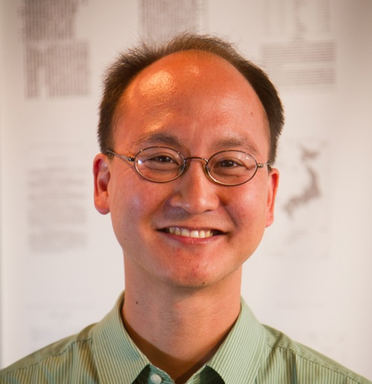
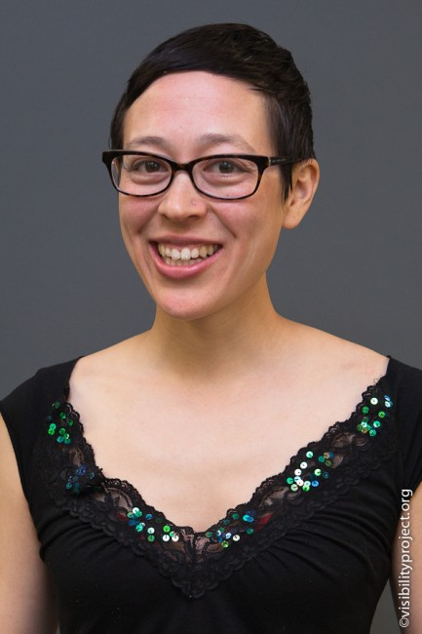
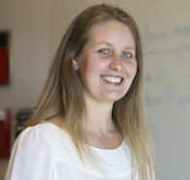


Getting Real About Experimentation
Leadership Learning Community Webinar
May 26, 2016
Eugene Eric Kim
Alison Lin
Jodie Tonita
Eden Kidane

Slide 2
1. Background
2. Why experiment?
3. What do we mean by “experimentation”?
4. How do we experiment effectively?
5. What are we learning?
TABLE OF CONTENTS

Slide 3
1. Background
2. Why experiment?
3. What do we mean by “experimentation”?
4. How do we experiment effectively?
5. What are we learning?
PART ONE

Slide 4
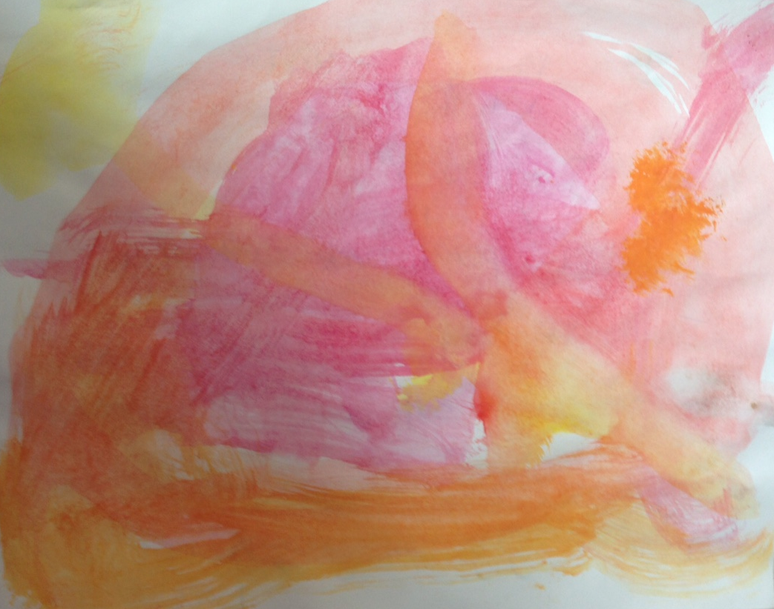
None of this is new...
Our influences:
Our backgrounds in science, technology, and public health
Lean Startup
Clark Kellogg on innovation
Rebecca Petzel and Future Forward
Lots of trial and error

Slide 5
... but it’s hard

Slide 6
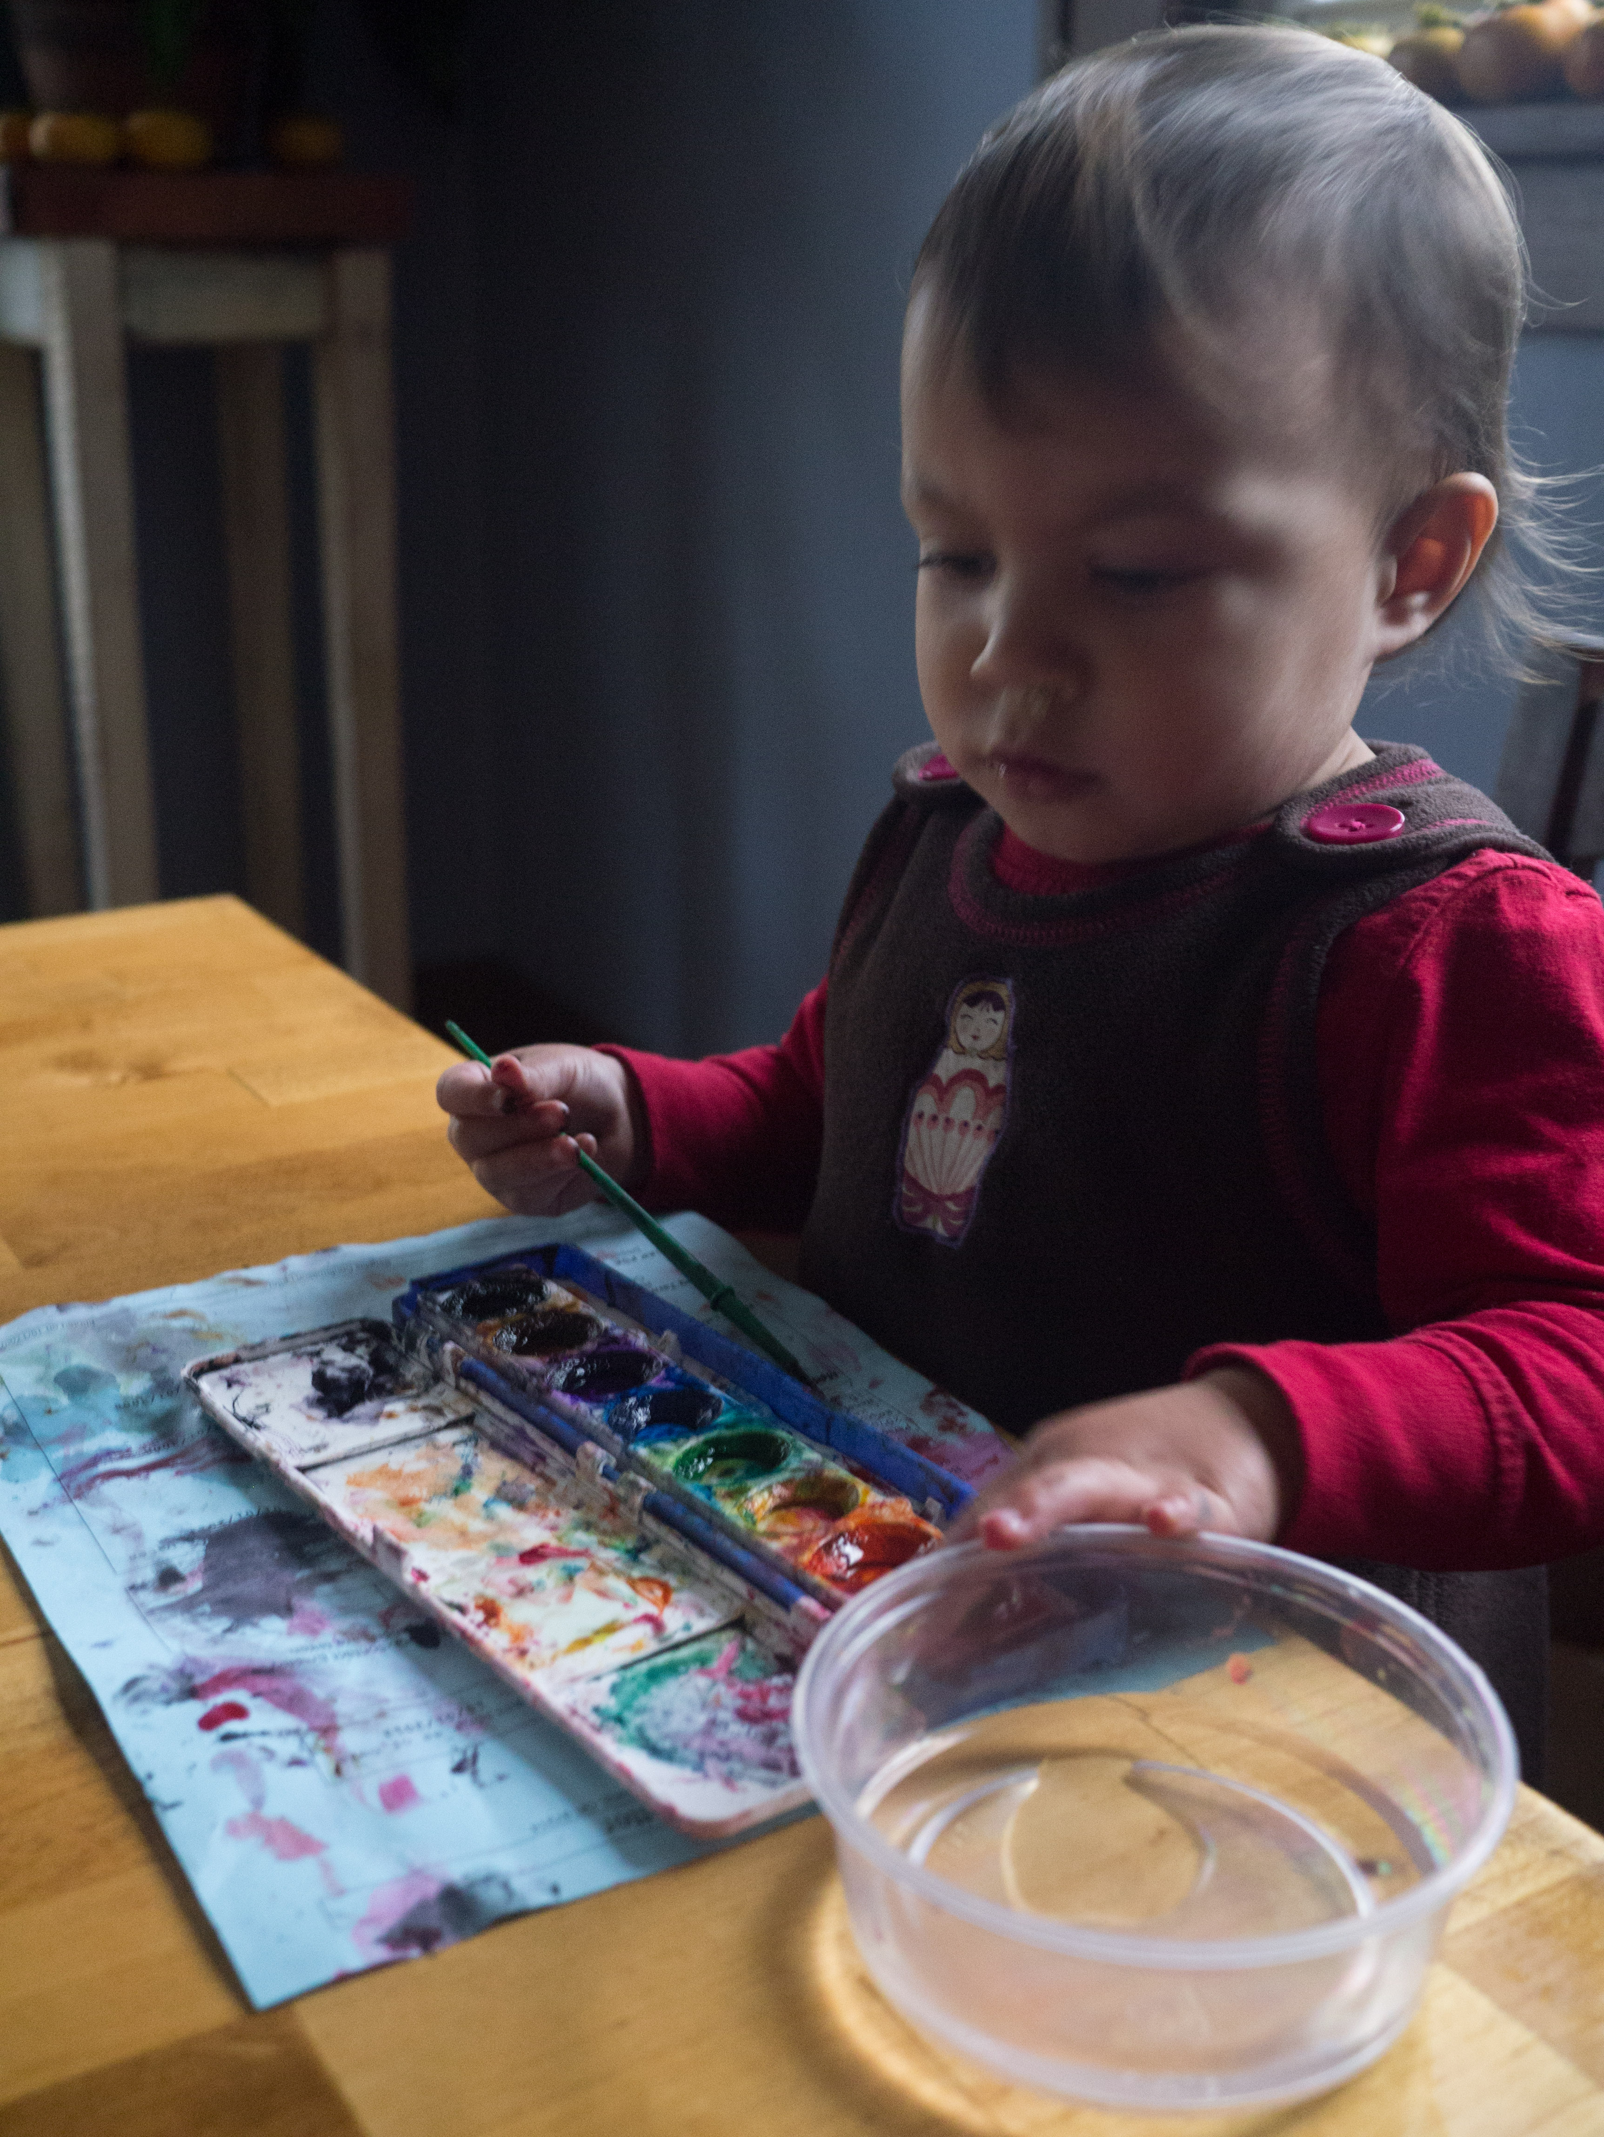
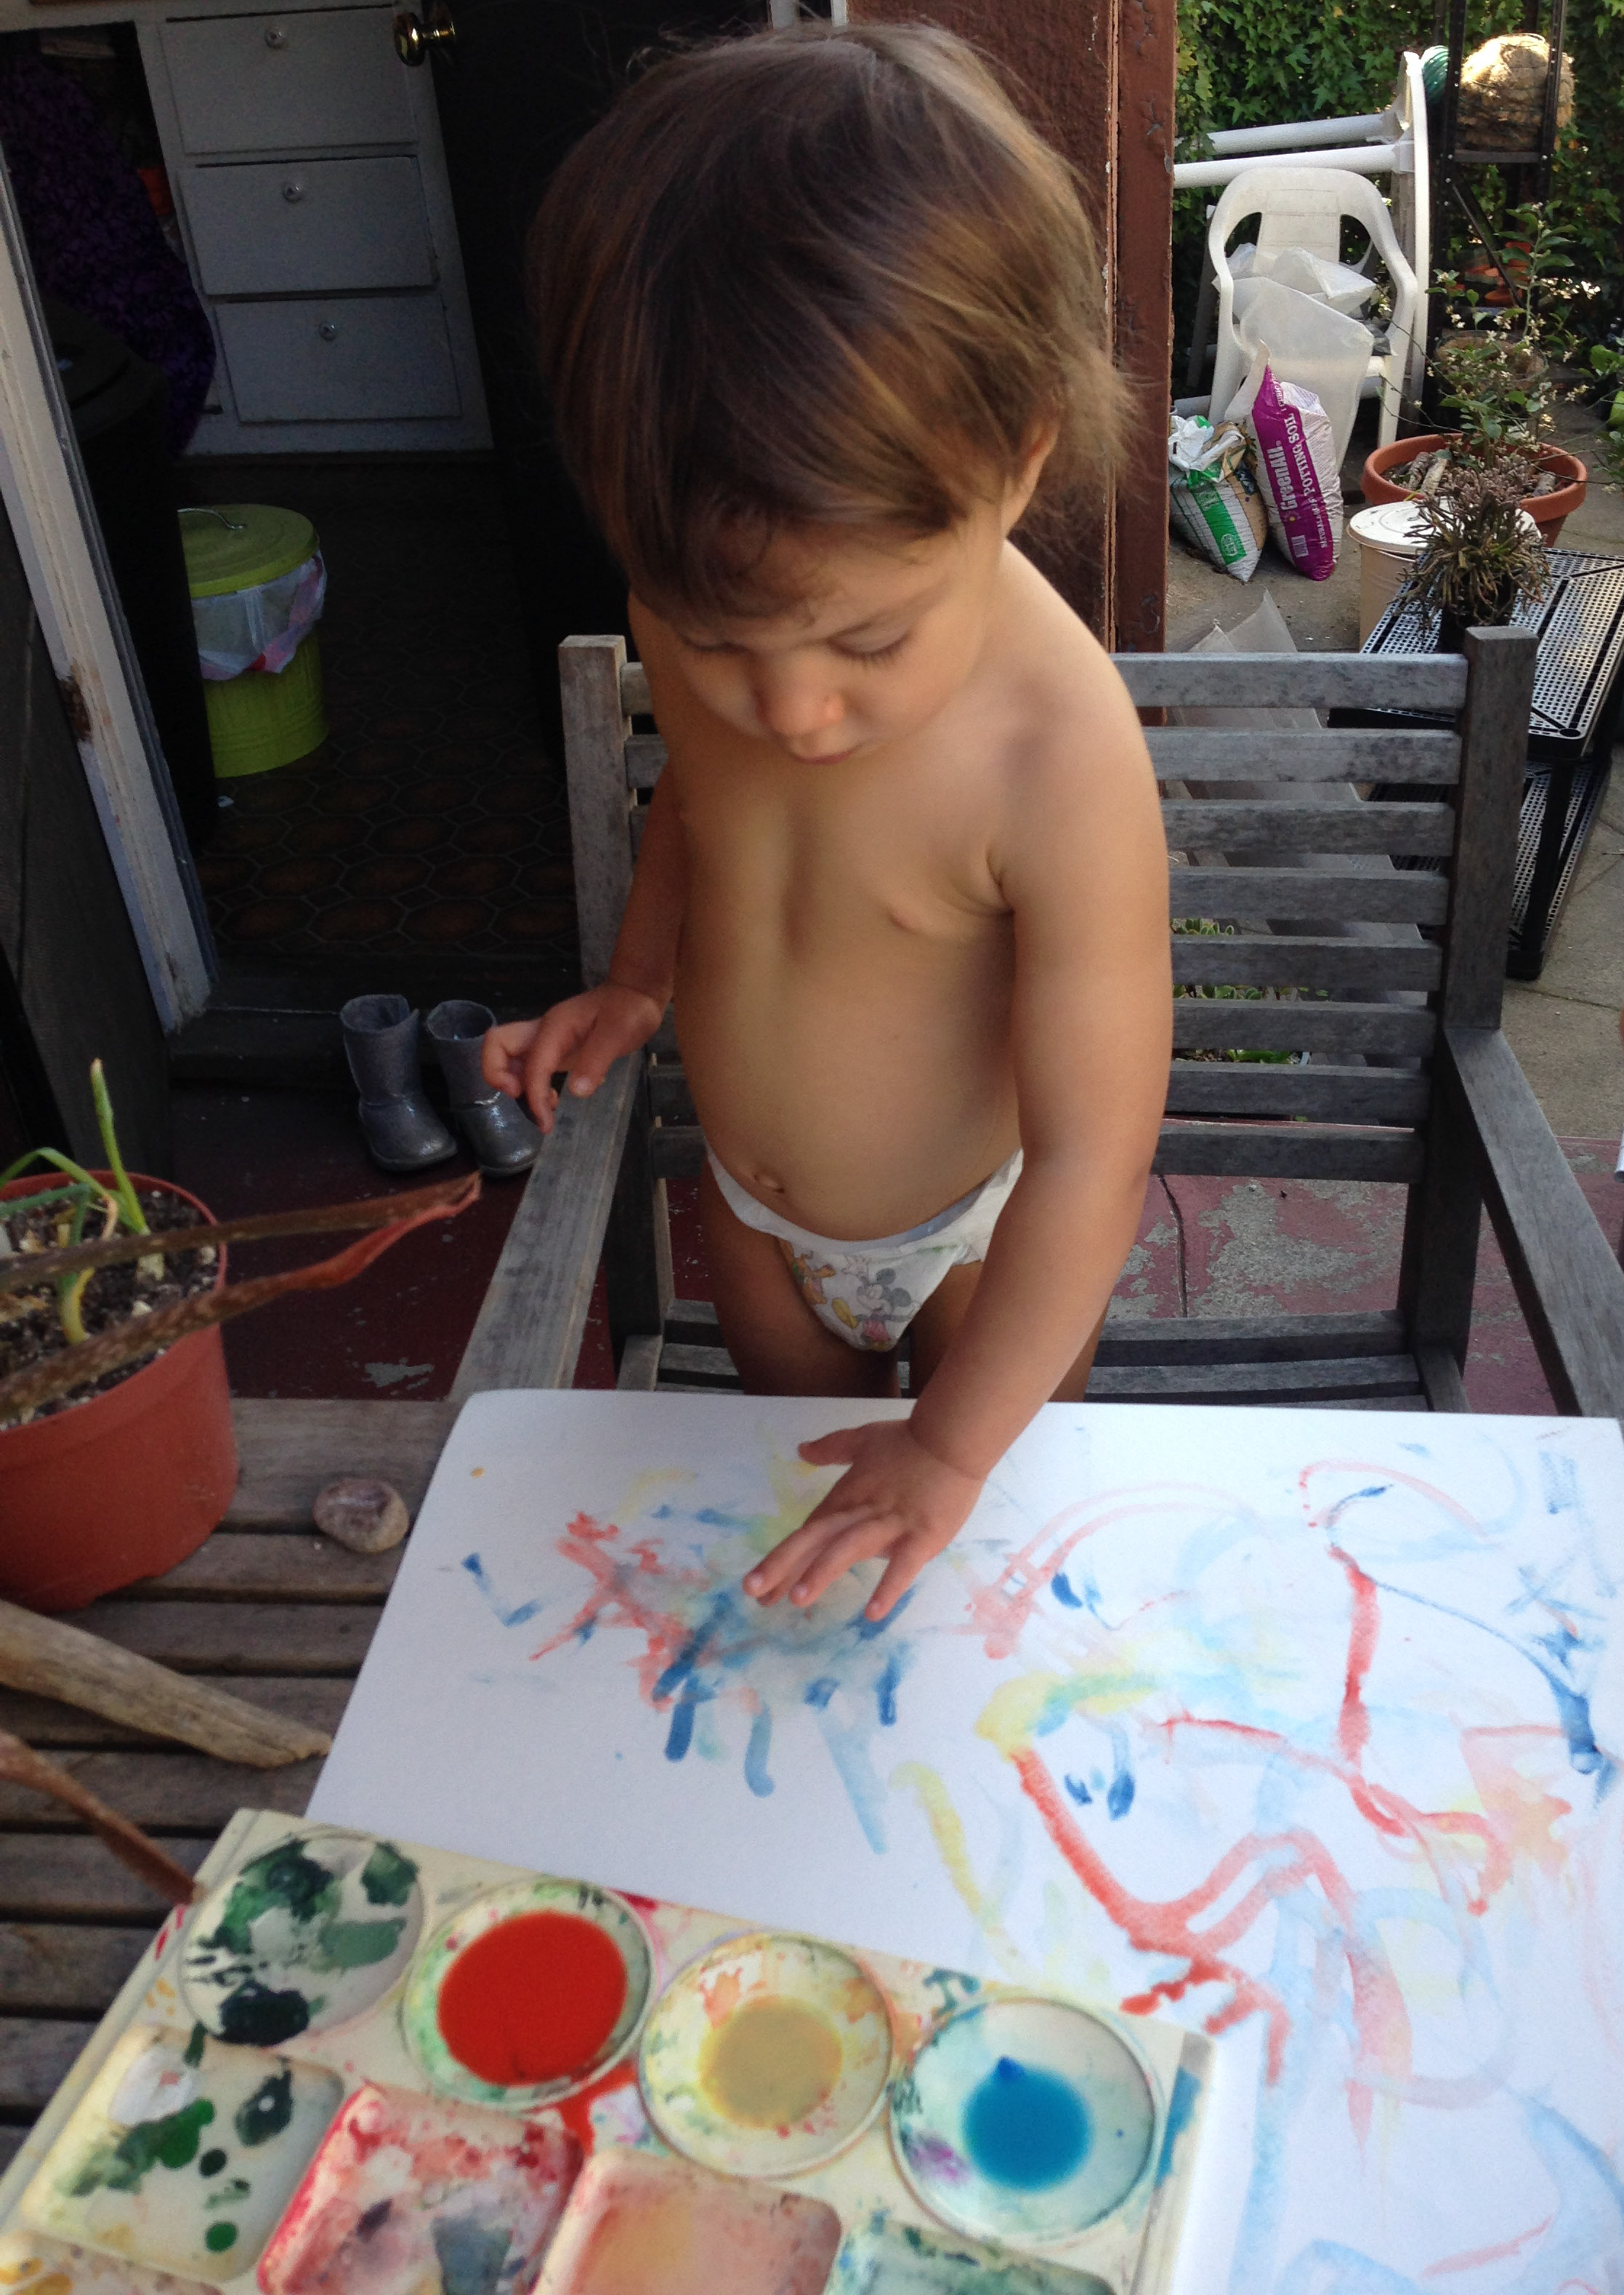
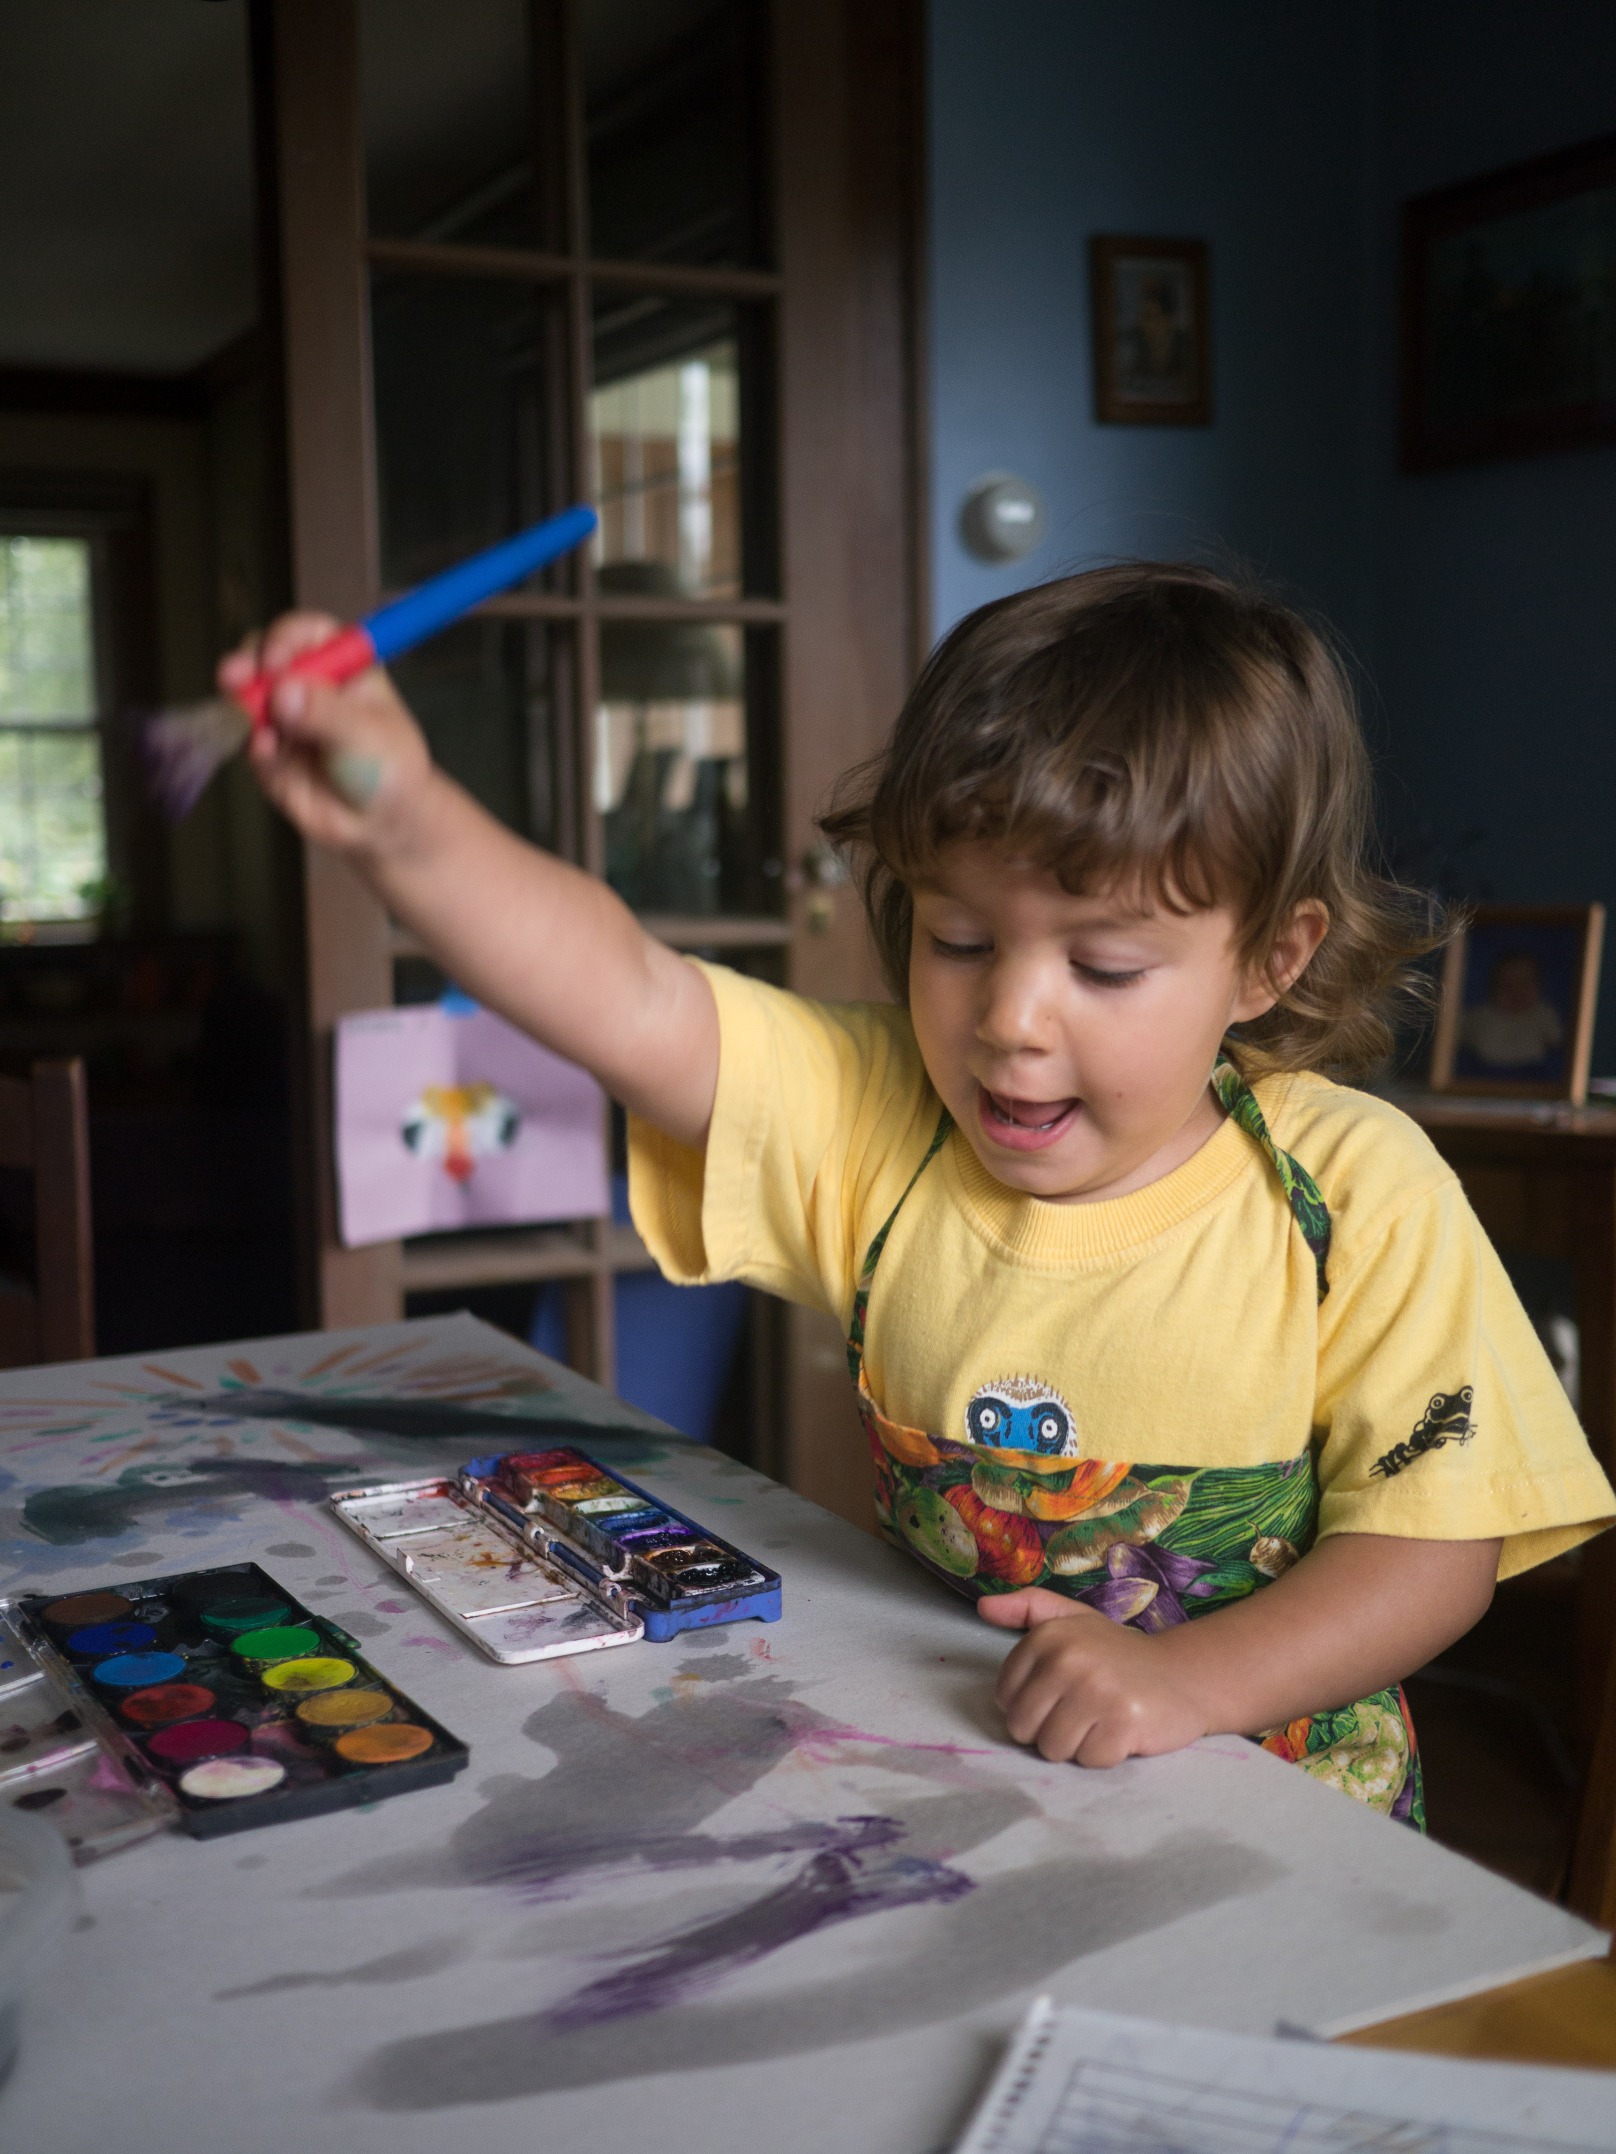
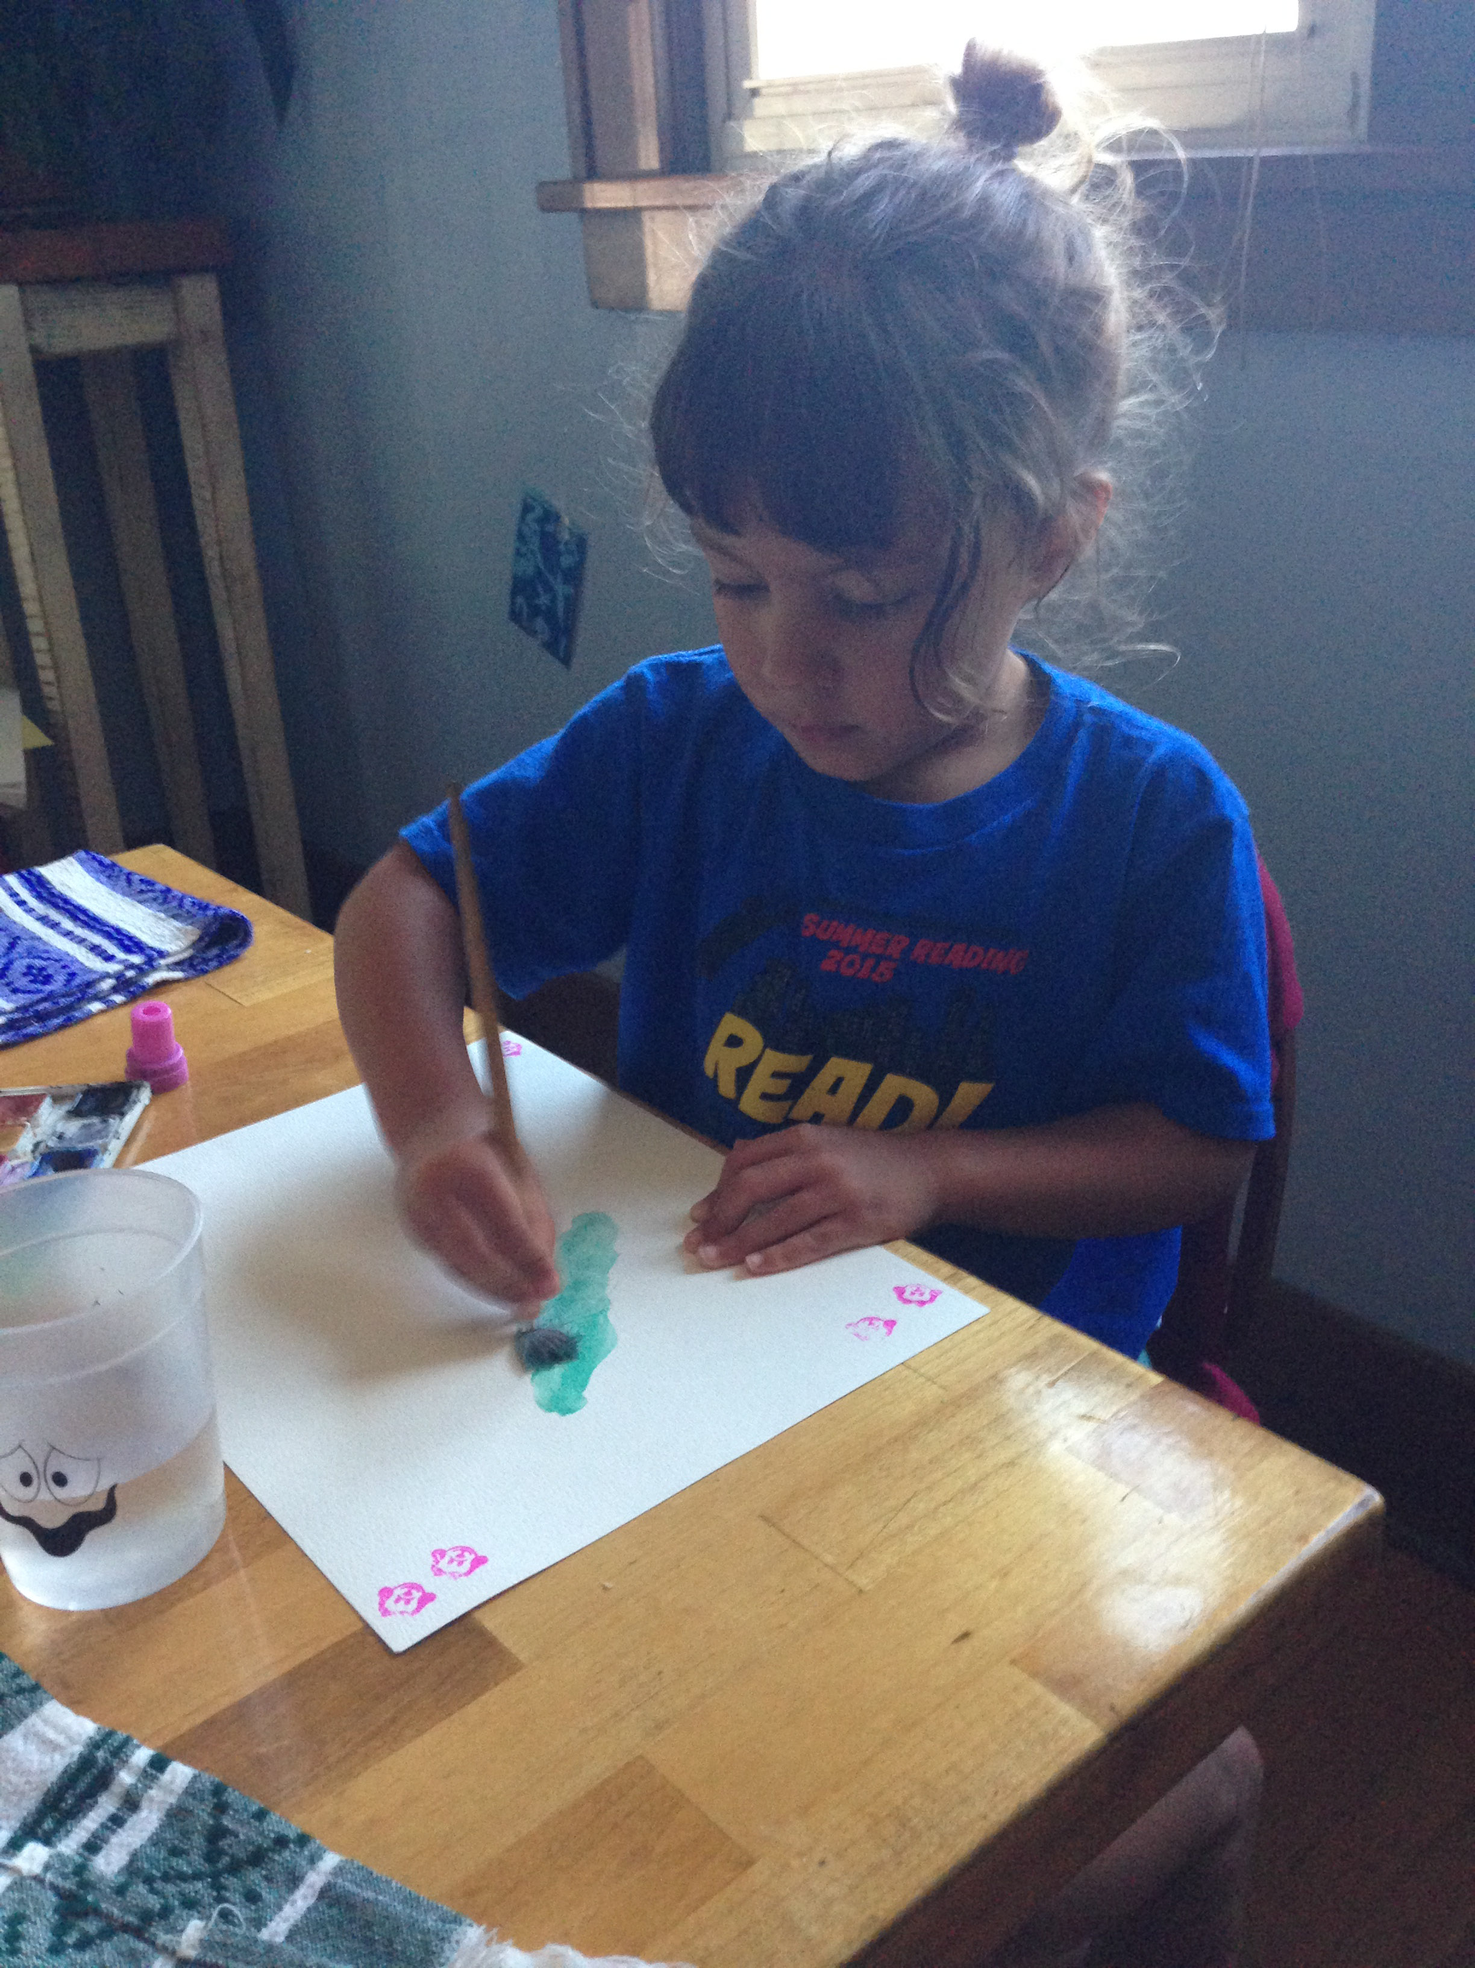
It requires practice

Slide 7
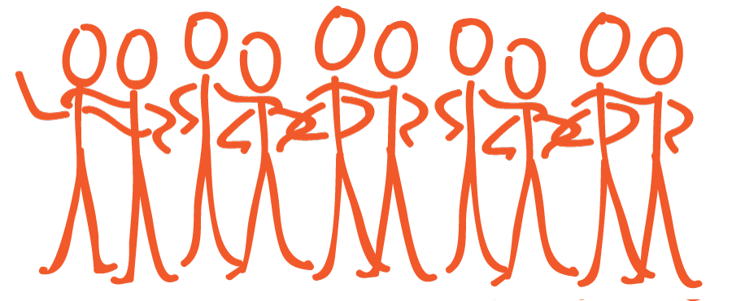
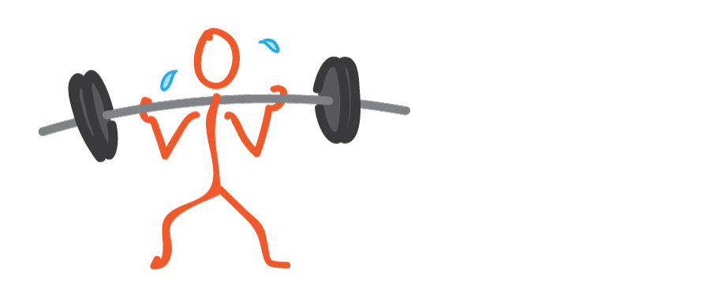

works with leaders across movements
to build power and make structural change
to create a more just, sustainable world for all.

Slide 8
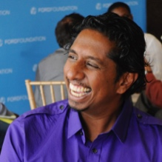

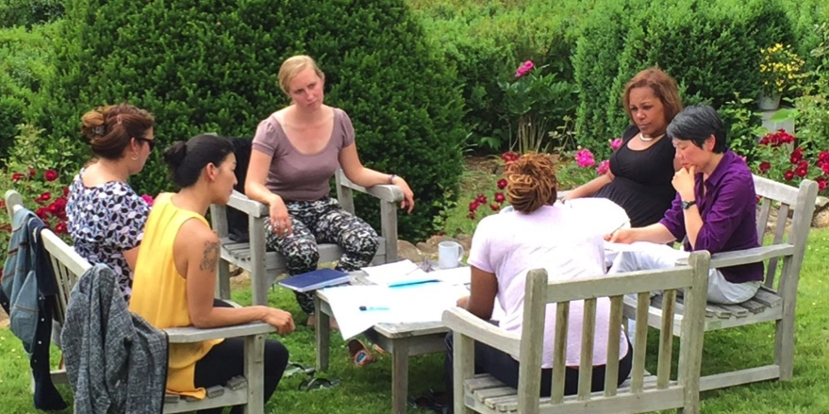
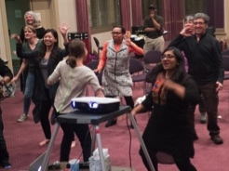
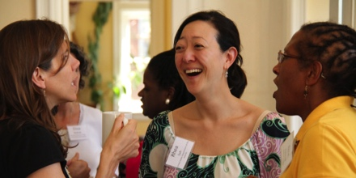

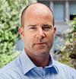
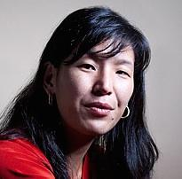
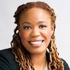
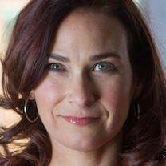




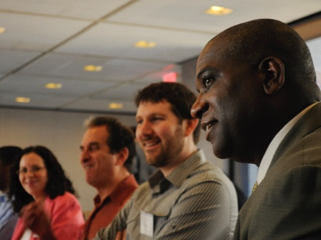

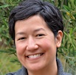

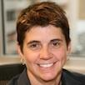
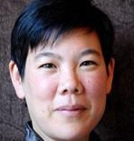
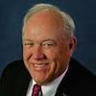

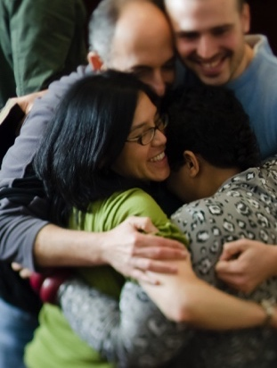

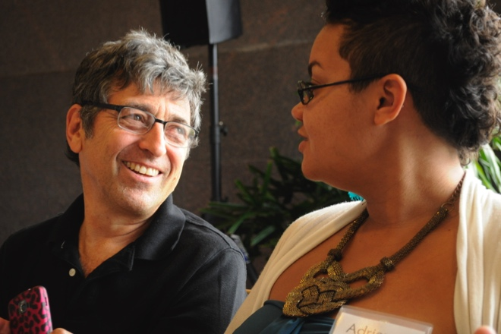
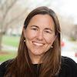
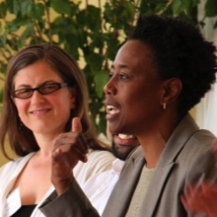
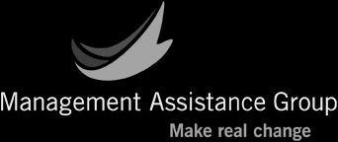
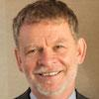


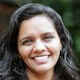

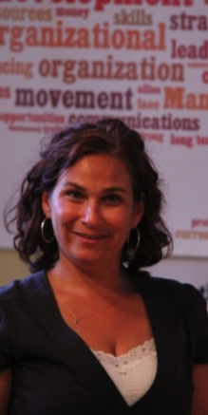

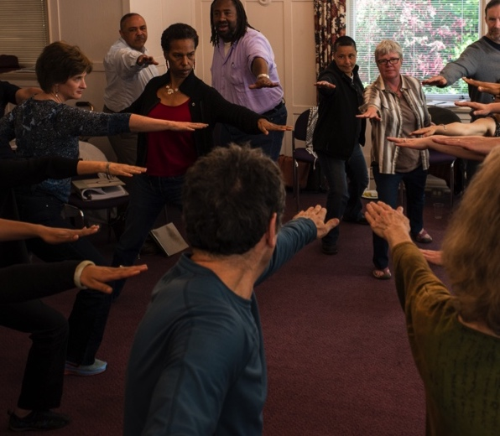
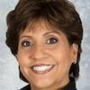
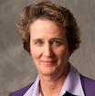
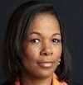

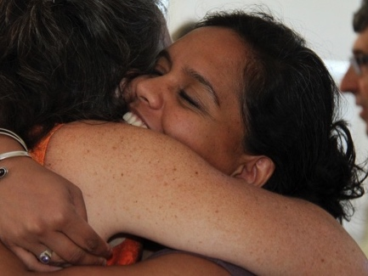


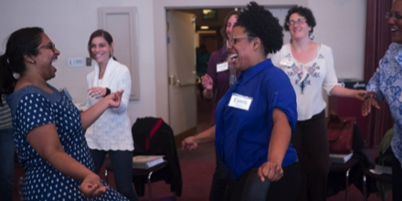
Wye River

Slide 9
1. Background
2. Why experiment?
3. What do we mean by “experimentation”?
4. How do we experiment effectively?
5. What are we learning?
PART TWO

Slide 10
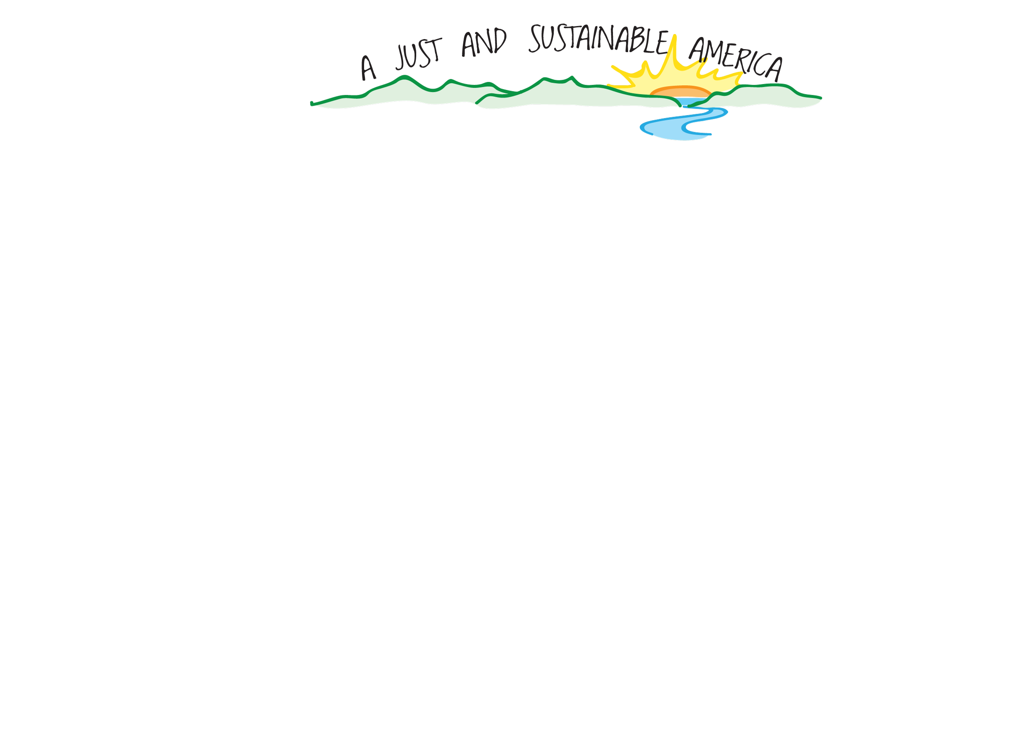
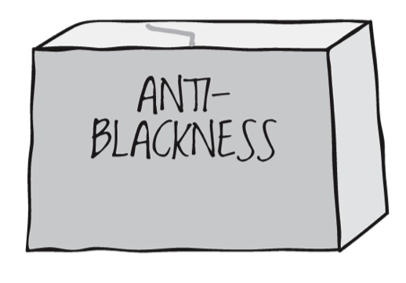
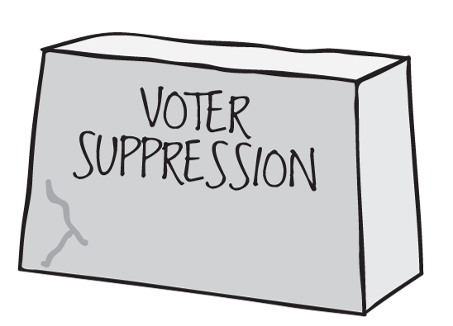
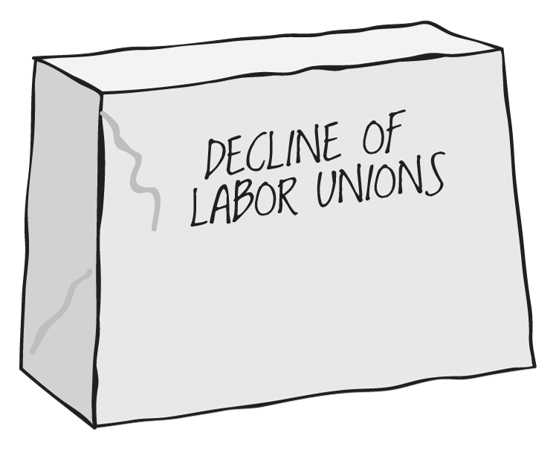
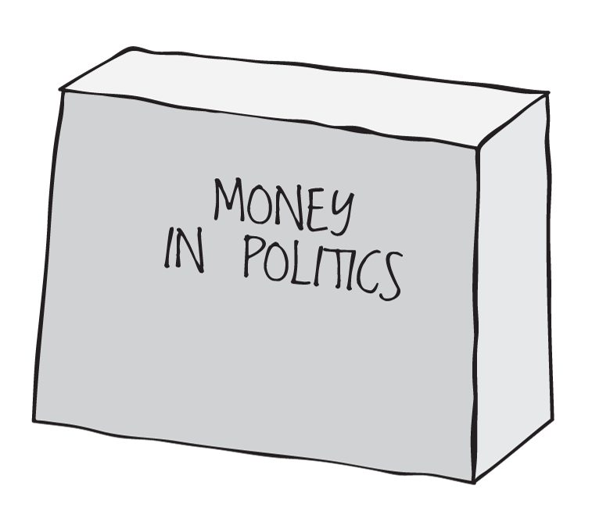
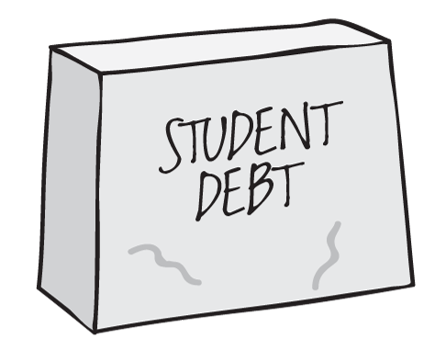
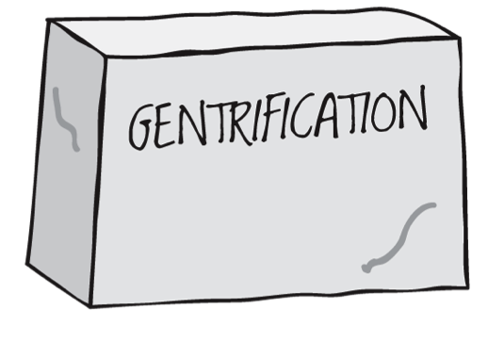
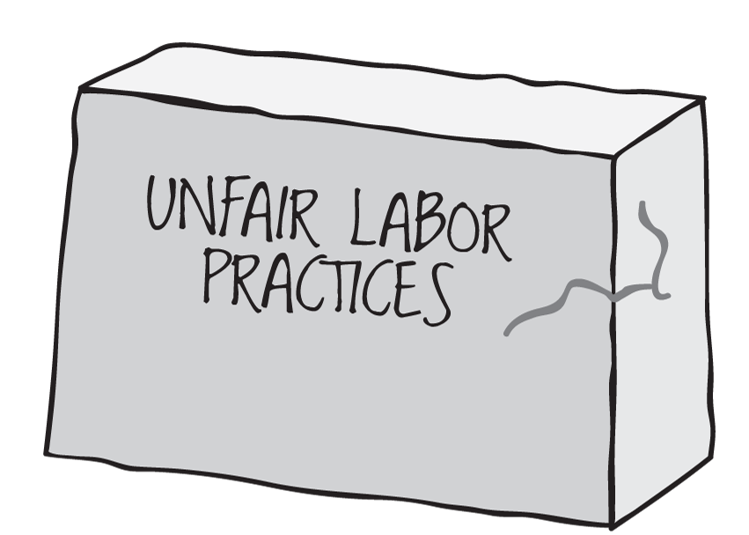
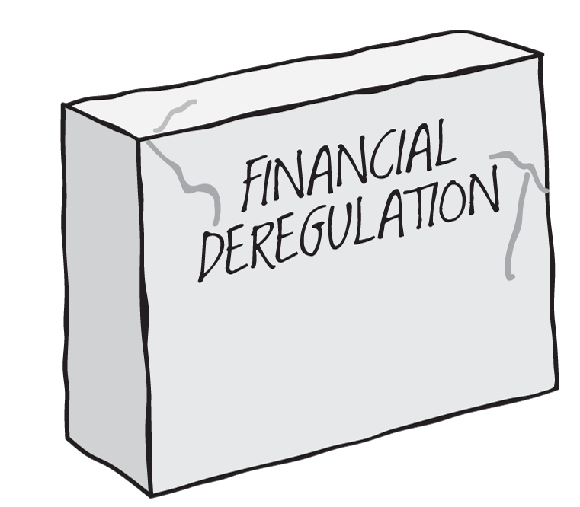
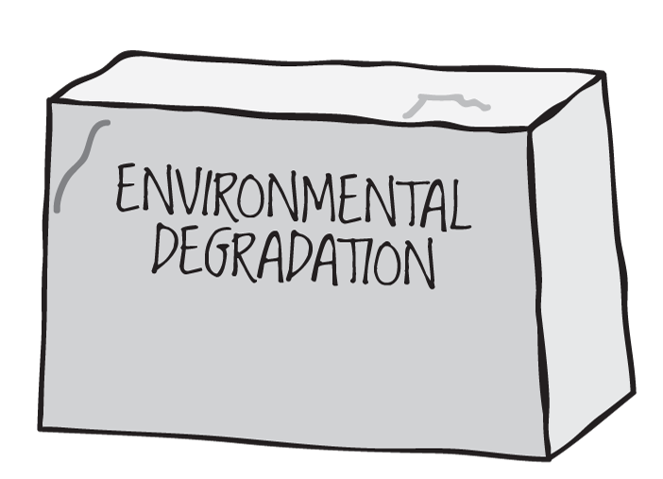
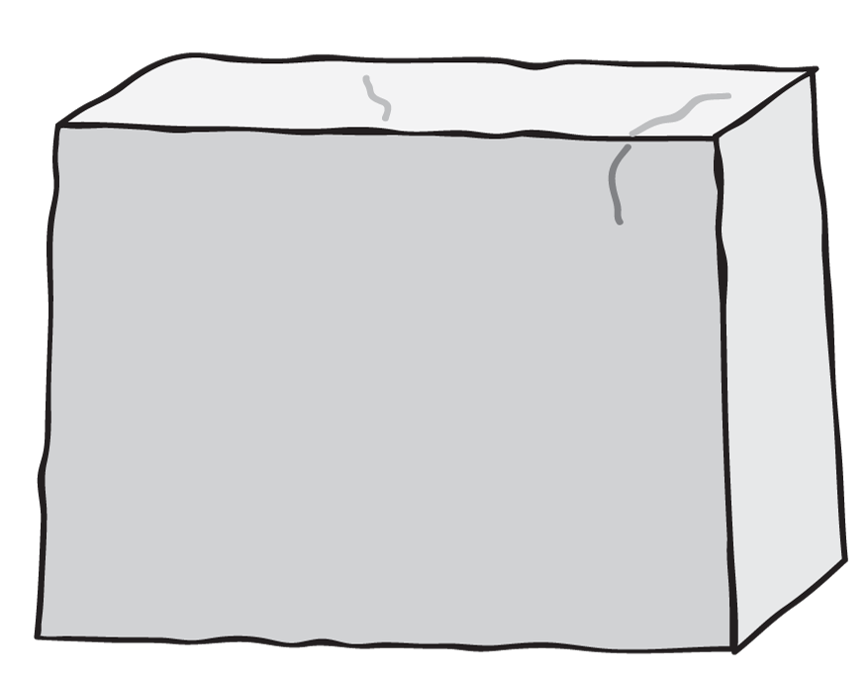
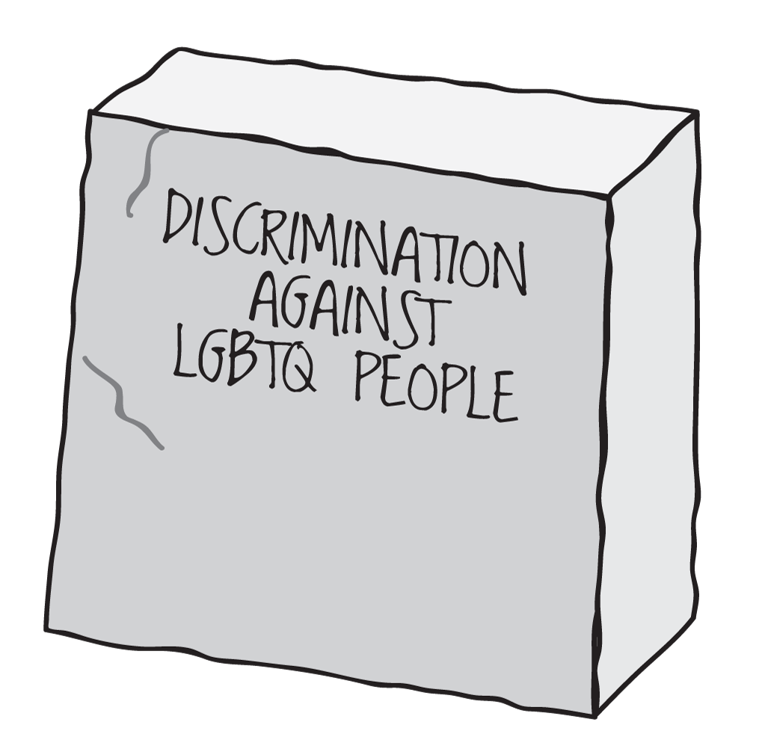
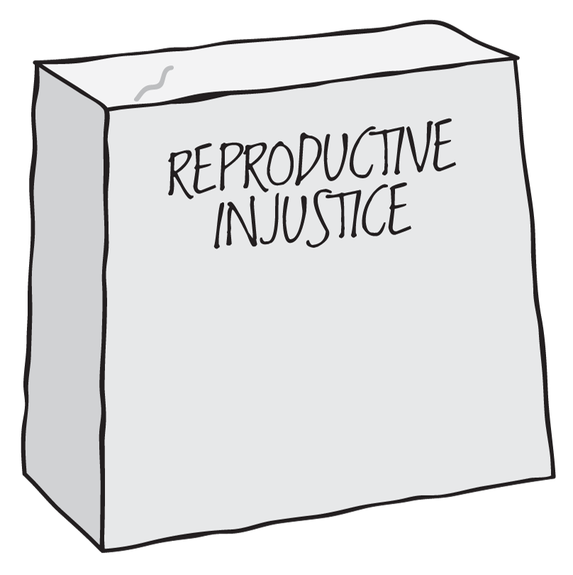












Slide 11
What Leaders Are Saying
We want
to experiment
together.
Develop
new practices
together.
Think long-term
together.
How?!

Slide 12
1. Background
2. Why experiment?
3. What do we mean by “experimentation”?
4. How do we experiment effectively?
5. What are we learning?
PART THREE

Slide 13

“experimentation” =
Fundamentally...
Trying stuff, and seeing what happens

Slide 14
Experimentation is a critical part of collectively learning, adapting, and improving.
So how do we do it well?

Slide 15
How do you...
… know what you’re actually learning?
… improve based on
what you’re learning?
… reduce the cost
of learning?
… do all this collectively?
You need ...
Space and time for meaning-making
Isolated assumptions
Small bets
Individual agency

Slide 16
This stuff is hard

Slide 17
It requires practice

Slide 18

A good experimentation process supports you through different stages of development...
Fly
Do all this collectively
Run
Learn, adapt quickly
Walk
Track results, make meaning
Crawl
Try stuff, see what happens
... toward the goal of
collective learning, adapting, and improvement

Slide 19
1. Background
2. Why experiment?
3. What do we mean by “experimentation”?
4. How do we experiment effectively?
5. What are we learning?
PART FOUR

Slide 20




Slide 21
1. Discovery — Stepping back
What question are you trying to answer, and why?
Regular group checkins
Individual coaching
Public domain templates for Discovery, Design, and Tracking
Dashboard for big picture tracking
2. Design — Getting specific
What’s your hypothesis?
How will you measure success?
When will the experiment start and end?
3. Making meaning
What did you learn?
What do you want to do next?

Slide 22


Design + Discovery Templates

Slide 23


Dashboard

Slide 24
STP Experiments (Sep 2015-May 2016)
Oct
Nov
Dec
Jan
Feb
Mar
Apr
May
Big picture, little picture
Just right connection
Stand up
Team meeting + stand up
Wye, help us!
Log it or lose it
My plate, your plate, sharing dessert
4th dimension
Plan to plan
Slackin’ in public
Get in formation
Movement calendars
YouTube Celebrities
YouTube Celebrities 2
Every Batman needs a Robin
Lisa Frank
Take down of the Energizer Bunny
Few folks, much abundance
Internally-facing experiments
Externally-facing experiments

Slide 25
STP Experiments (Sep 2015-May 2016)
Oct
Nov
Dec
Jan
Feb
Mar
Apr
May
8
Big picture, little picture
Just right connection
Stand up
Team meeting + stand up
Wye, help us!
Log it or lose it
My plate, your plate, sharing dessert
4th dimension
Plan to plan
months
18
Slackin’ in public
Get in formation
Movement calendars
YouTube Celebrities
YouTube Celebrities 2
Every Batman needs a Robin
Lisa Frank
experiments
Take down of the Energizer Bunny
Few folks, much abundance

Slide 26
STP Experiments (Sep 2015-May 2016)
Oct
Nov
Dec
Jan
Feb
Mar
Apr
May
Big picture, little picture
Just right connection
Stand up
Team meeting + stand up
Wye, help us!
Log it or lose it
My plate, your plate, sharing dessert
4th dimension
Plan to plan
Slackin’ in public
Get in formation
Movement calendars
YouTube Celebrities
YouTube Celebrities 2
Every Batman needs a Robin
Lisa Frank
Take down of the Energizer Bunny
A deeper dive
Few folks, much abundance

Slide 27

How might we quantify
each staff’s capacity to understand when there are opportunities to collaborate?
My plate, your plate, just dessert!
If we know how full each other’s plates are and what is on them, then we will more efficiently complete our main tasks and identify places for collaboration.
26
OCT

Slide 28
My plate, your plate, just dessert!
I don’t agree with the premise.
Try it anyway, Eden!
26
OCT

Slide 29
What We Learned
x
The missing element is collective prioritization.
If we know how full each other’s plates are and what is on them, then we will more efficiently complete our main tasks and identify places for collaboration.
Pivot
Create additional time during weekly staff meetings to discuss organizational priorities.
26
2
OCT
NOV

Slide 30

Just right connections
My plate, your plate, sharing dessert

Slide 31
How might we improve our team meetings to help us feel more connected and engaged?
Just right connections
If we regularly connect to the why of our work and connect with organizational priorities, then we’ll be able to increase STP’s impact and feel connected.
26
2
4
OCT
NOV
NOV

Slide 32
What We Learned
Connecting this way worked, but we didn’t want to cram this into our weekly team meeting.
✓
Pivot
If we regularly connect to the why of our work and connect with organizational priorities, then we’ll be able to increase STP’s impact and feel connected.
Do very brief daily standups to review organizational and individual priorities.
26
2
4
OCT
NOV
NOV

Slide 33

Just right connections
My plate, your plate, sharing dessert
Stand up

Slide 34
How might we improve our team meetings to help us feel more connected and engaged?
Stand up
If we have quick, daily stand-up meetings, then we’ll feel more individually focused, avoid energy drops, reduce time in all-team meetings, and increase our overall team effectiveness.
26
2
4
10
OCT
NOV
NOV
NOV

Slide 35
What We Learned
Sweet spot!
✓
If we have quick, daily stand-up meetings, then we’ll feel more individually focused, avoid energy drops, reduce time in all-team meetings, and increase our overall team effectiveness.
26
2
4
10
18
OCT
NOV
NOV
NOV
NOV

Slide 36
1. Background
2. Why experiment?
3. What do we mean by “experimentation”?
4. How do we experiment effectively?
5. What are we learning?
PART FIVE

Slide 37
This stuff is hard

Slide 38
It requires practice

Slide 39
More Information
Acknowledgements
http://fasterthan20.com/lean/
http://stproject.org/
We were conceptually inspired by Lean Startup and Clark Kellogg’s work on innovation.
The basis of our tools, templates, and process came from work Eugene and Alison did in 2015 with Rebecca Petzel and Duende’s Amy Wu on Future Forward
<http://futureforward.duende.us/>.
Amy also created the diagrams about Social Transformation Project and the daunting challenges its network is trying to address.
The Crawl / Walk / Run / Fly framework is adapted from Beth Kanter. Icons are from The Noun Project: Baby by James Bickerton / Student by Lemon Liu / Sprint by Desbenoit.
Many thanks to Leadership Learning Community for hosting this webinar!
<http://leadershiplearning.org/>
Contact Us
Eugene Eric Kim / @eekim on Twitter
eekim@fasterthan20.com
http://fasterthan20.com/
Alison Lin
alisonlinconsulting@gmail.com
http://networkecology.org/
Jodie Tonita
jodie@stproject.org
Eden Kidane
eden@stproject.org

Slide 40

Experimentation Muscles
Pausing
Asking generative questions
Navigating power
Acting strategically
Working iteratively
Asking for help
Giving / receiving feedback
Experimentation Mindsets
Bias toward action. “The sooner I start trying, the faster I’ll learn.”
Improvement is a practice. “The more I try, the better I’ll get.”
Fail fast forward. “Mistakes are part of learning.”
Slow down to speed up. “I’ll work smarter if I slow down.”
Diversity and data. “I have blind spots. I need to compensate for them to get the best results.”

